Slide 1

Getting to Know Your Data

Slide 2
What’s in the data?
Notes:
https://static1.squarespace.com/static/542c1a60e4b0a87901dddeb7/t/544ff774e4b0dc63a5d9c697/1414526926724/?format=2500w

Slide 3
Tukey
Exposure, the effective laying open of the data to display the unanticipated, is to us a major portion of data analysis.

Slide 4
Tukey (cont.)
Exposure, the effective laying open of the data to display the unanticipated, is to us a major portion of data analysis. Formal statistics has given almost no guidance to exposure;

Slide 5
Tukey (cont.)
Exposure, the effective laying open of the data to display the unanticipated, is to us a major portion of data analysis. Formal statistics has given almost no guidance to exposure; indeed, it is not clear how the informality and flexibility appropriate to the exploratory character of exposure can be fitted into any of the structures of formal statistics so far proposed.

Slide 6
Tukey (cont.)
Nothing—not the careful logic of mathematics, not statistical models and theories, not the awesome arithmetic power of modern computers—nothing can substitute here for the flexibility of the informed human mind.

Slide 7
Tukey (cont.)
Nothing—not the careful logic of mathematics, not statistical models and theories, not the awesome arithmetic power of modern computers—nothing can substitute here for the flexibility of the informed human mind.
Accordingly, both approaches and techniques need to be structured so as to facilitate human involvement and intervention.

Slide 8
Summary Statistics
Useful to look at clean data, that you understand and trust
Can be misleading
Notes:
As we saw in Anscombe’s quartet

Slide 9
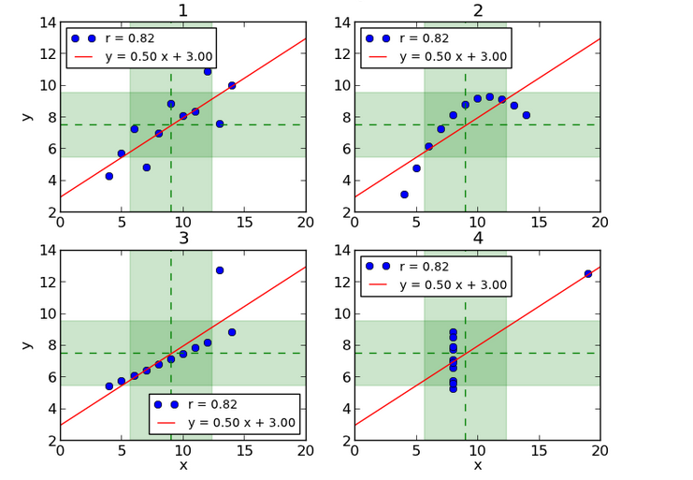
Summary Statistics
Can be misleading
Notes:
As we saw in Anscombe’s quartet
http://informatique-python.readthedocs.io

Slide 10
Data Munging
Notes:
http://www.forbes.com/sites/gilpress/2016/03/23/data-preparation-most-time-consuming-least-enjoyable-data-science-task-survey-says/#20fd4a617f75
http://medriscoll.com/post/4740157098/the-three-sexy-skills-of-data-geeks
mention how bad this visual is?

Slide 11
Data Munging
60%
Notes:
this slide is better

Slide 12
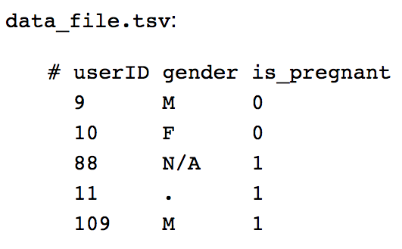
Data Munging
Notes:
.?
and a pregnant male?

Slide 13
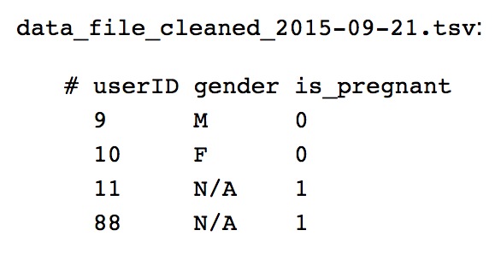
Data Munging
Notes:
we want to end up with something like this.

Slide 14
Data Quality Hurdles
Missing Data
Erroneous Values
Type Conversion
Entity Resolution
Data Integration
Notes:
no measurements, redacted, ...? misspelling, outliers, ...? e.g., zip code to lat-lon diff. values for the same thing? effort/errors when combining data

Slide 15
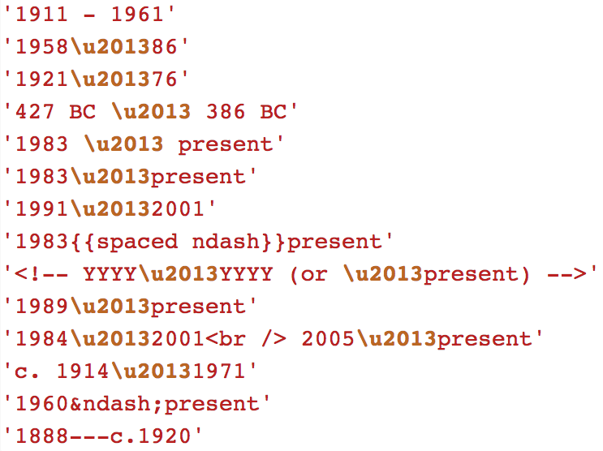
More Data Munging
Notes:
date ranges??

Slide 16
5.77967973162 3.26834145824 0.06418251738 4.38979192127 4.68302244707 4.82366715649 4.68587041117 0.04360063509 5.90498807235 4.3618070355 0.0017977901 4.9891841837 4.56259294774 5.44050157565 5.19592386044 15.6959515181 3.22732340991 5.57228018649 3.7148892443 5.00286245308 4.68302244707 4.82366715649 4.68587041117 0.04360063509 5.90498807235 4.68302244707
Data filtering
Notes:
http://dps.alaska.gov/awt/Images/VesselWoldstad.jpg

Slide 17
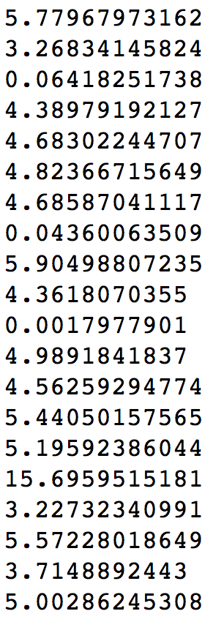

Slide 18
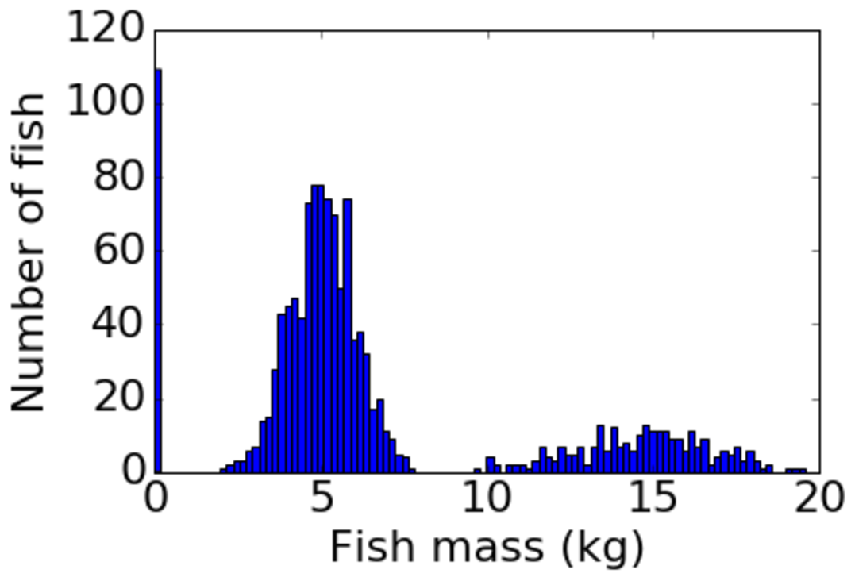
Notes:
AHA! lot’s of 0’s on the scale in our data.
Hard to see this without looking at the histogram

Slide 19
“The first sign that a visualization is good is that it shows you a problem in your data.”
—Wattenberg

Slide 20


